Slide 1
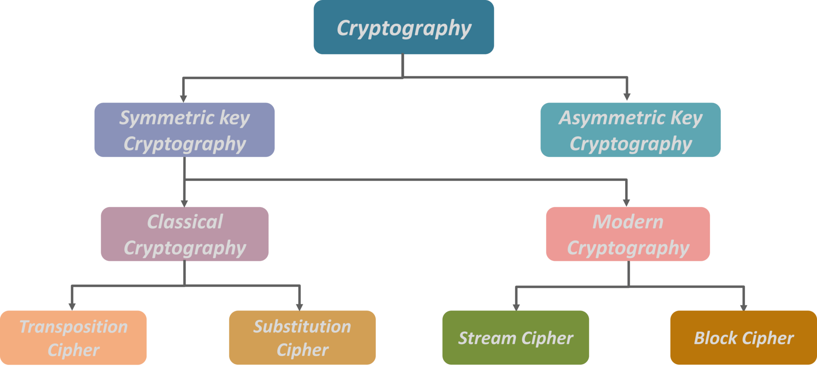

Slide 2
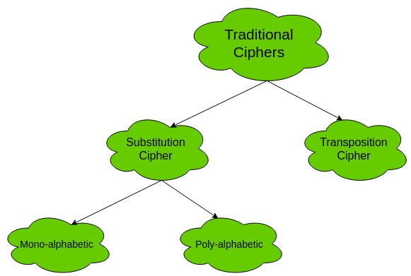
Traditional Symmetric –Key Cipher

Slide 3
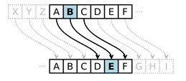
Substitution Cipher
A simple way of encrypting message by substituting one character at a time or multiple characters by another character.
Substitution means replacing something with other thing.
In cryptography we replace characters and digits by other character or digits.
Substitution is one of the oldest and simplest way of encryption.

Slide 4
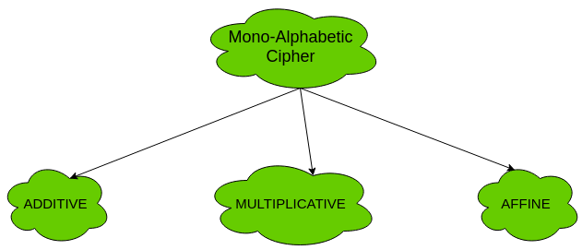
A substitution cipher replaces one symbol with another Substitution ciphers can be categorized as either monoalphabetic ciphers or polyalphabetic cipher
Substitution Cipher

Slide 5
Monoalphabetic Substitution Cipher
A monoalphabetic substitution cipher, also known as a simple substitution cipher, relies on a fixed replacement structure. That is, the substitution is fixed for each letter of the alphabet.
A simple example is where each letter is encrypted as the next letter in the alphabet: "a simple message" becomes "B TJNQMF NFTTBHF”

Slide 6
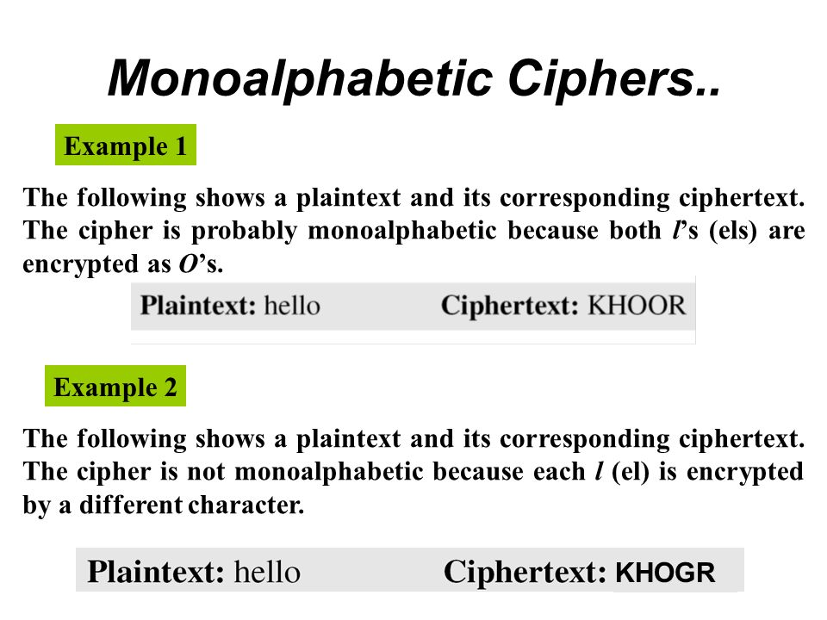
Monoalphabetic Ciphers
In monoalphabetic substitution, the relationship between a symbol in the plaintext to a symbol in the cipher text is always one to one

Slide 7
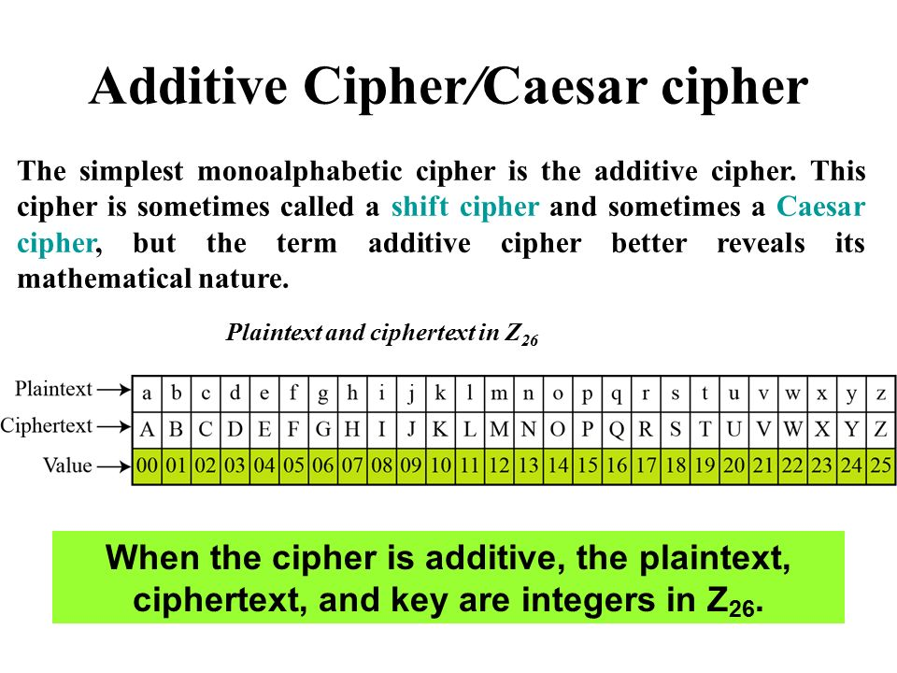

Slide 8
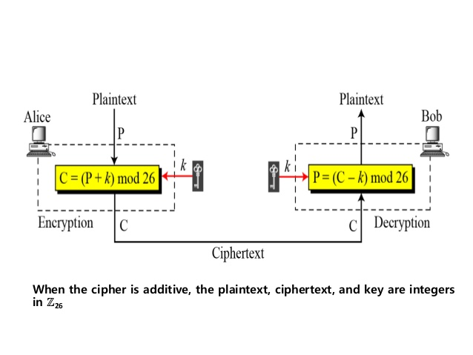
Additive Cipher

Slide 9
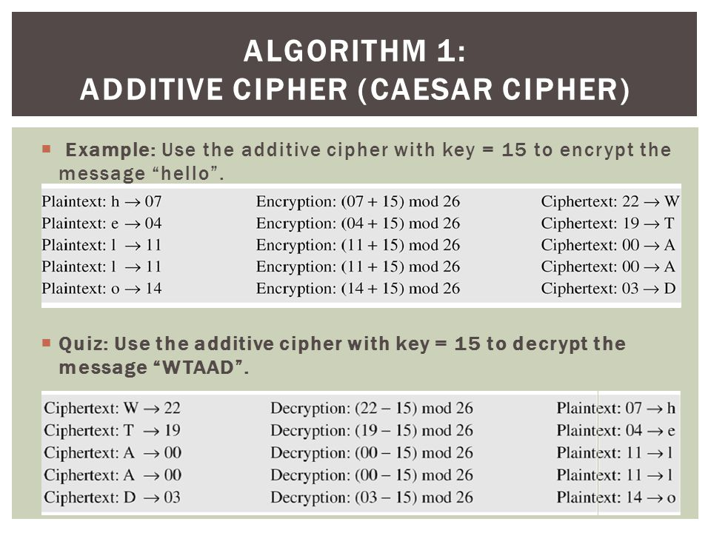

Slide 10
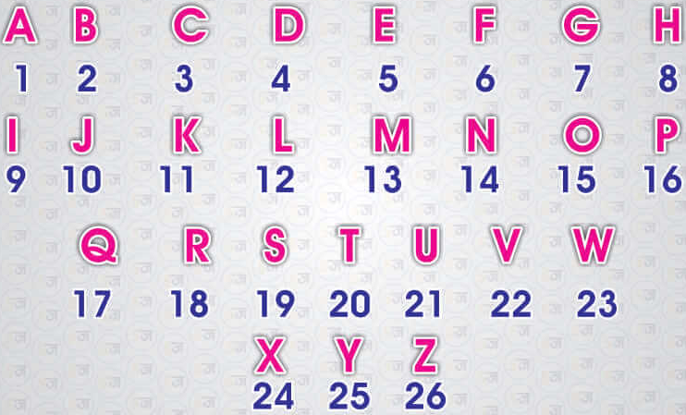
Example 2
Example:
Message : APPLE (Considering A=1…Z=26) key: 3
Caesar Cipher - Shift by 3
ABCDEFGHIJKLMNOPQRSTUVWXYZ
DEFGHIJKLMNOPQRSTUVWXYZABC
So,
Encryption : En(X) = (x+k) mod 26
A = 1+3 mod 26 => D
P= 16 + 3 mod 26 => S
P= 16 + 3 mod 26 => S
L = 12+3 mod 26 = 15 => O
E = 5+3 mod 26 = 8 => H
Cipher Text = DSSOH
Decryption : Dn(X) = (x - k) mod 26
D =4-3 mod 26 = 1=>A
S= 19-3 mod 26 = 16 =>P
S= 19-3 mod 26 = 16 =>P
O=15-3 mod 26 = 12 => L
H=8-3 mod 26 = 5 =>E

Slide 11
Attacks on Caesar Cipher
The most common attack on caesar cipher is Brute force attack.
Because only 25 shift is possible in it.
Anyone can break it by starting shifting from 1 shift to 25 shift and hel/she will get all possible encoding.
It can be broken by frequency analysis:
a) Letter frequency
b) Word size analysis

Slide 12
Multiplicative Cipher
The multiplicative cipher is similar to additive cipher except the fact that the key bit is multiplied to the plain-text symbol during encryption. Likewise, the cipher-text is multiplied by the multiplicative inverse of key for decryption to obtain back the plain-text
C = (M * k) mod n M = (C * k⁻¹) mod n
where, k⁻¹ -> multiplicative inverse of k (key)

Slide 13
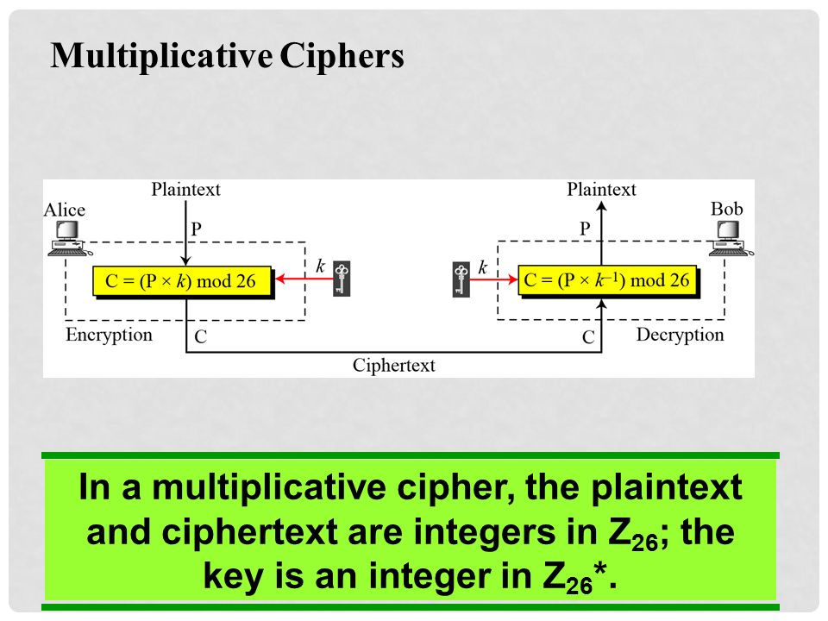

Slide 14
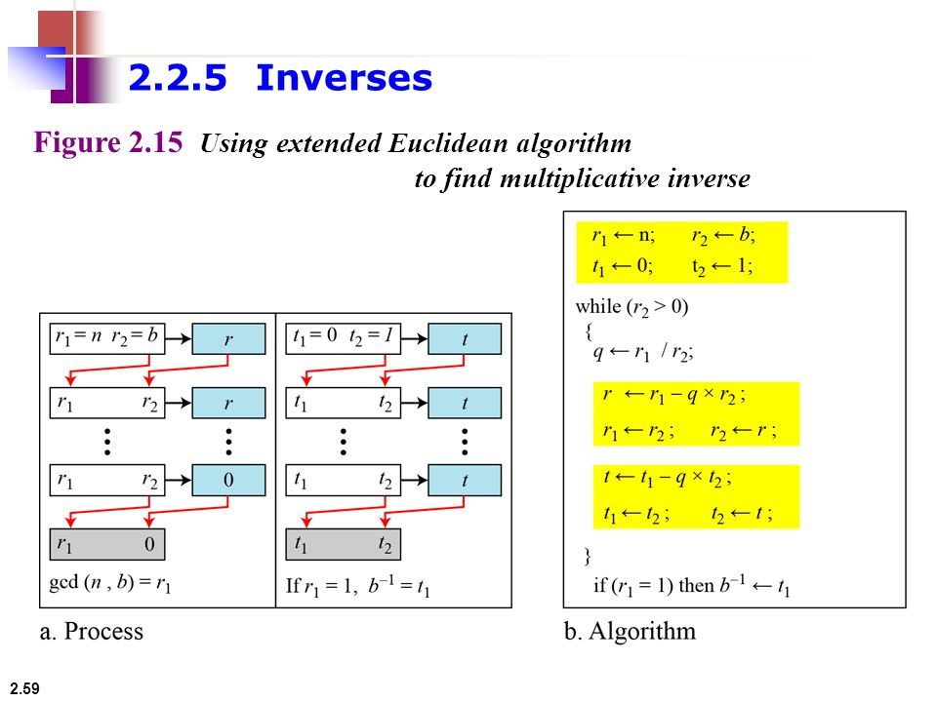
Example find multiplicative inverse of 11 in Z₂₆ Here n=26 and b=11

Slide 15
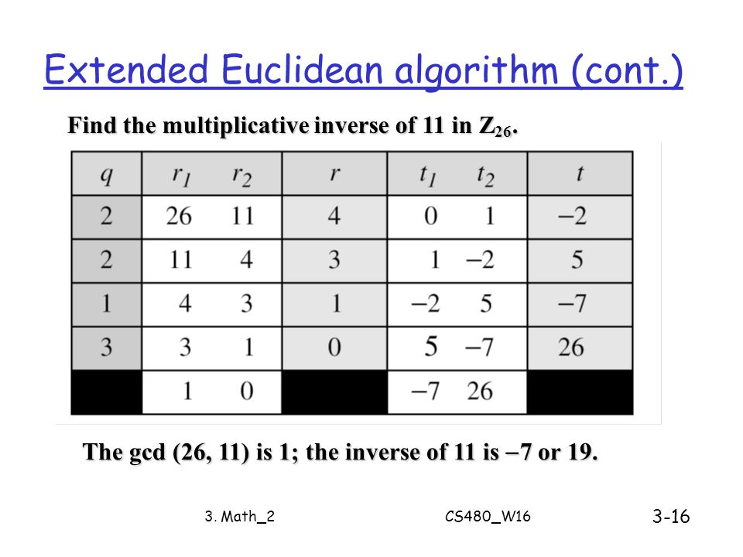

Slide 16
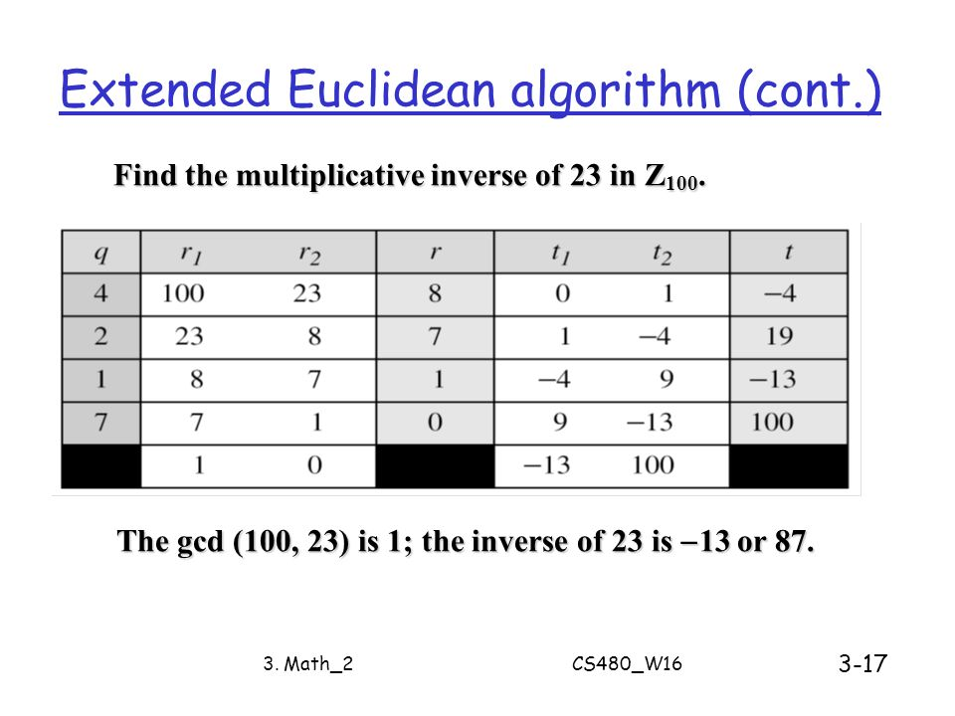

Slide 17
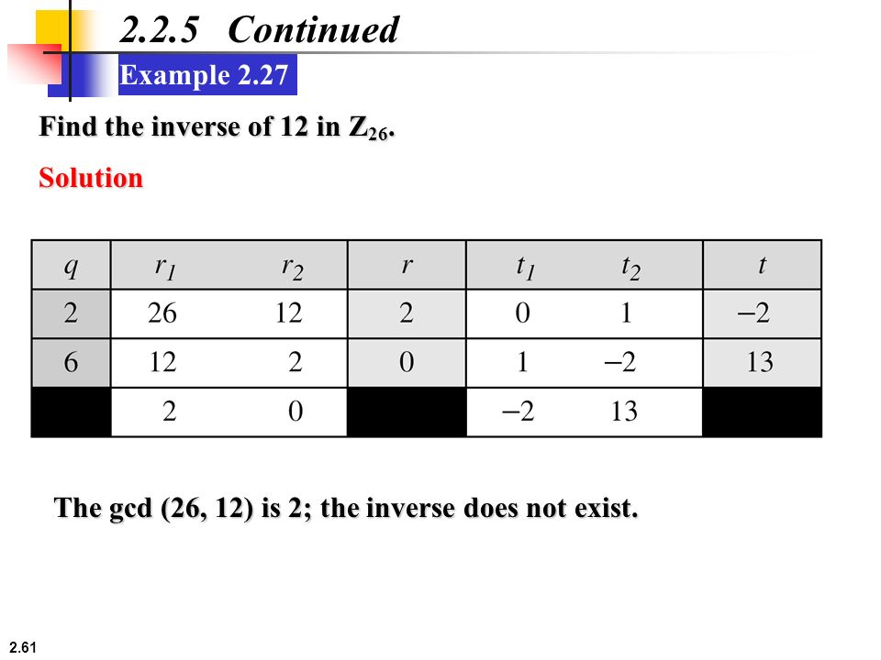

Slide 19
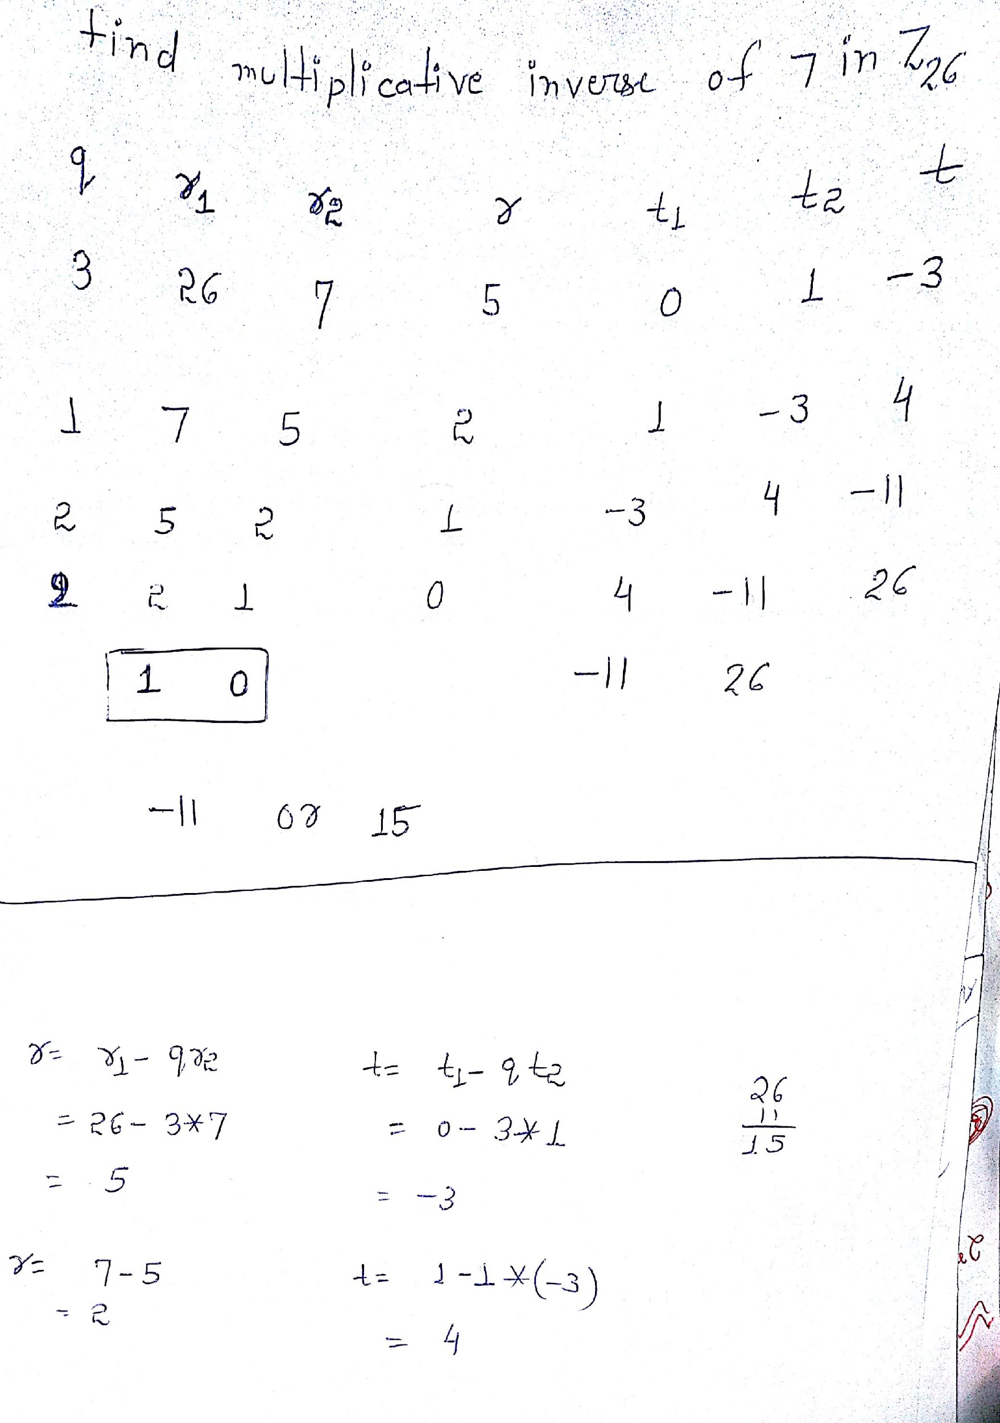

Slide 20
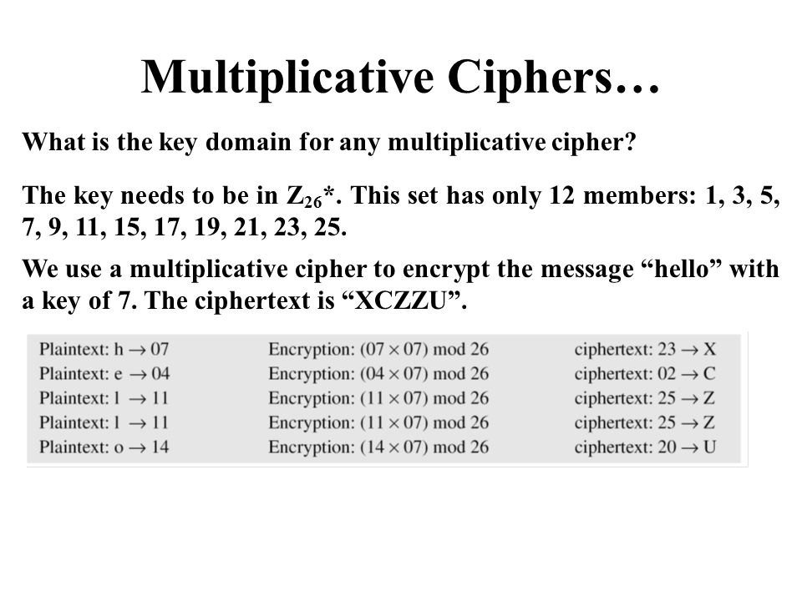

Slide 21
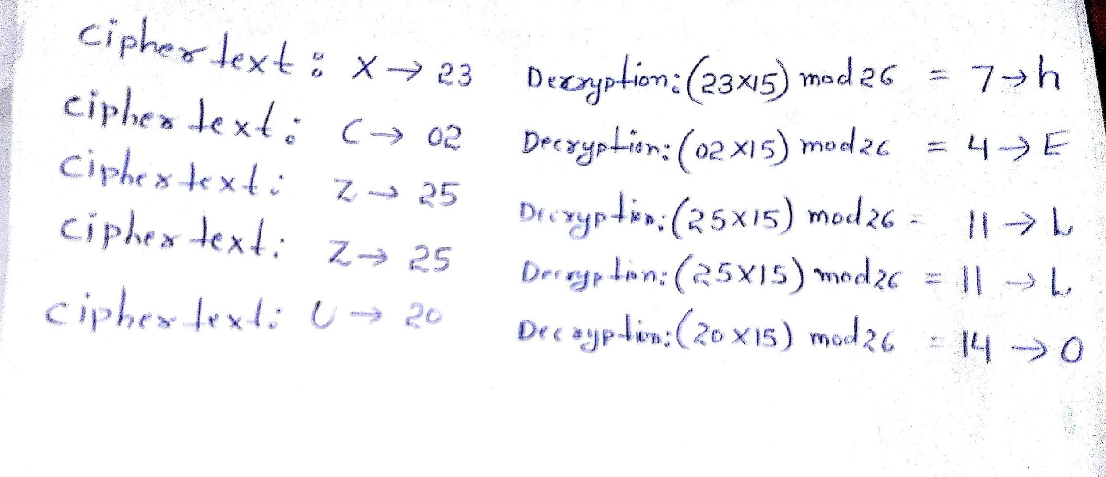
Decryption Procedure

Slide 22
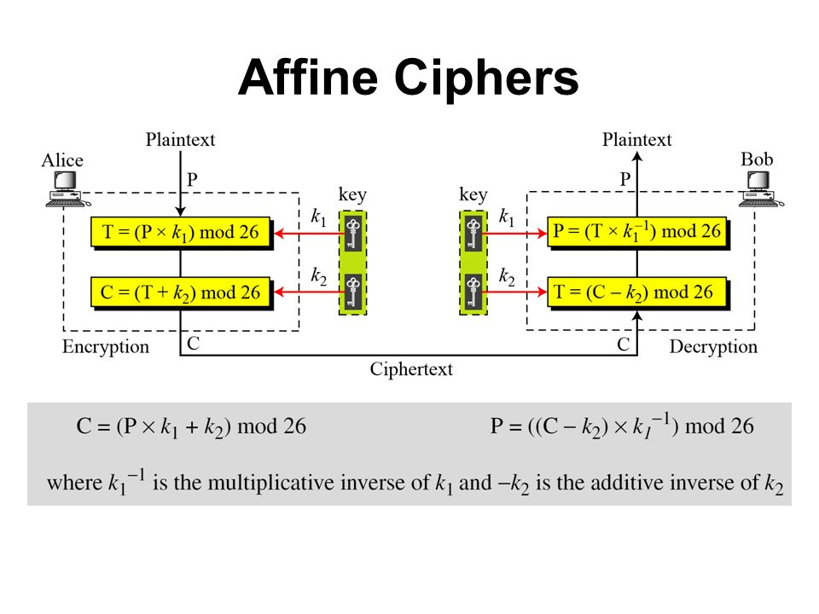

Slide 23
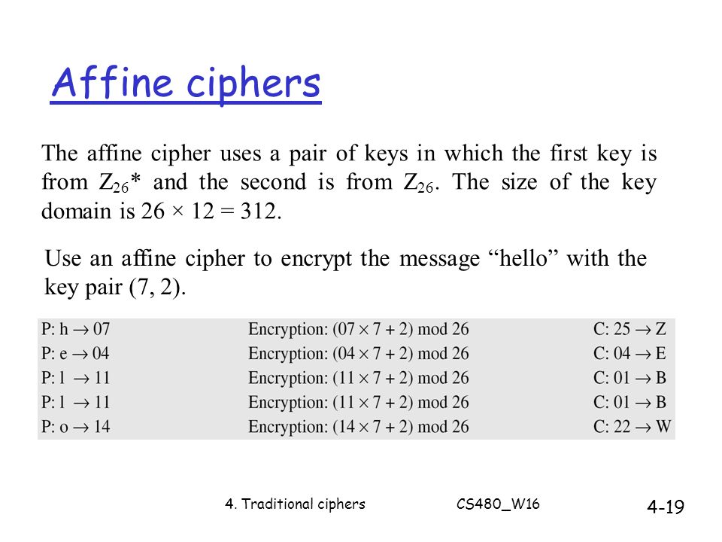

Slide 24
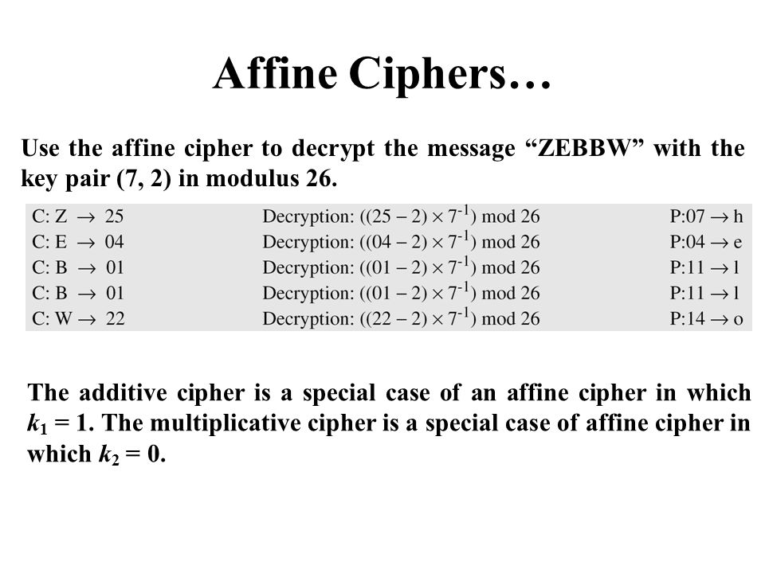

Slide 25
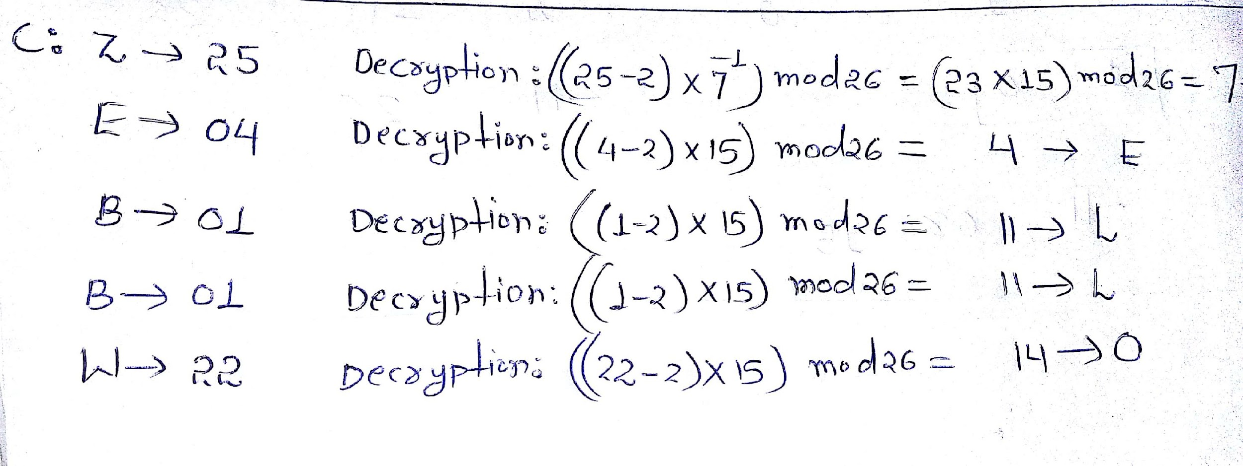
Decryption Procedure

Slide 26
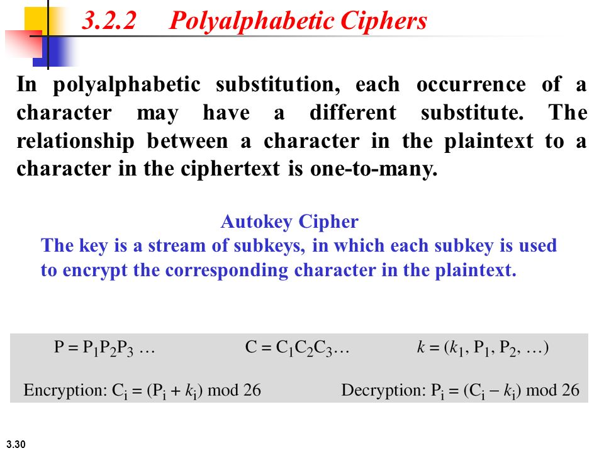

Slide 27
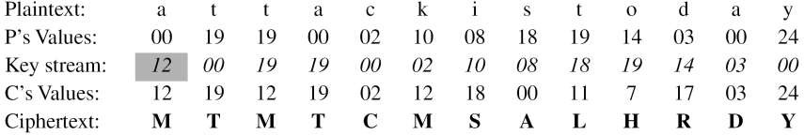
Example
Assume that Alice and Bob agreed to use an autokey cipher with initial key value k1 = 12. Now Alice wants to send Bob the message “Attack is today”. Enciphering is done character by character.

Slide 28
